Slide 1
Group 3 Project 3
Jance Ng
Jin Min Wood
Adrian Kong

Slide 2
Problem Statement
We are part of the marketing team for a tv/movie production company. Our company is interested to sign a contract with either Netflix or Disney+ to stream our shows on their platform. Before we make our decisions, we would like to see which platform suits our tv/movie genre the best.
To get the sentiments of the users of the platform, we dive into their subreddit community to extract what the community have to say about these platforms.
We will make use of natural language processing and classification models to classify reddit posts into either netflix or disneyplus. This will allow us to make use of the review of our tv/movies and run it through the classification model to see which platform is a better fit for our tv/movie.

Slide 3


Scope of project
Subreddits:
Length of post: at least 30 words
No. of unique posts: 9,800 each

Slide 4
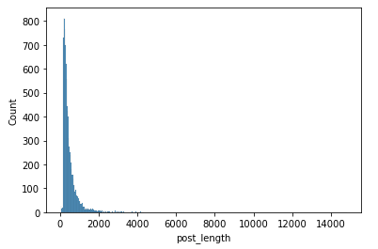
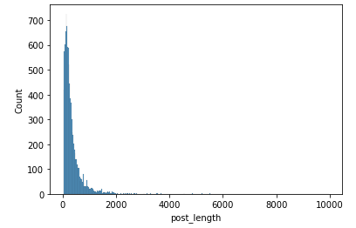
Exploratory Data Analysis
Netflix
DisneyPlus

Slide 5
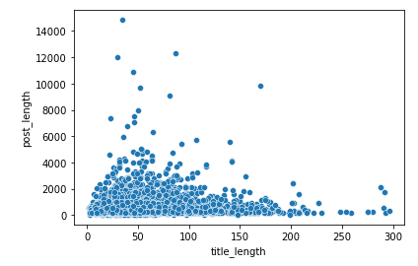
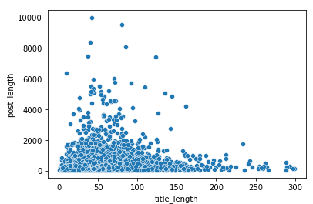
Exploratory Data Analysis
Netflix
DisneyPlus

Slide 6
Modelling
Baseline model:
50% accuracy since equal number of posts from each subreddit
Models we will be using to try to beat the baseline score:
Classification Algorithm - Random Forest and Logistic Regression
Vectorizer - Countvectorizer and TF-IDF vectorizer
Word form - Tokenized, Lemmatized and Stemming
Notes:
Before we begin our modelling process, we would need to have a baseline model to evaluate against our models. Since we have equal number of posts from each subreddit, our baseline model has an accuracy of 50% to classify posts into either netflix or disneyplus.
The models we will be trying out will be a permutation of the following:
For classification algorithm, we have random forest and logistic regression
For vectoriser, we have countvectoriser and term frequency-inverse document frequency vectoriser. Let me just quickly explain what these two are - CountVectorizer simply counts the number of times a word appears in a post, while TF-IDF Vectorizer takes into account not only how many times a word appears in a post but also how important that word is to the whole 19,600 posts that we have extracted from both subreddits.
For word form, we have the tokenized form, lemmatized form and stemming form. Tokenized simply breaks down the posts into word by word, while both lemmatizing and stemming take words and attempt to return a base form of the word. Both are similar, but they have different algorithm to return the base word.

Slide 7
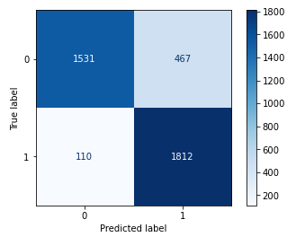
Model 1ai
Classification Algorithm | Random Forest
Vectorizer | TF-IDF
Word Form | Tokenized
Train set accuracy score | 0.86096
Test set accuracy score | 0.85280
F1 score | 0.86265
0 = DisneyPlus and 1 = Netflix
Notes:
For our first model,
We used random forest, tf-idf and the tokenized word form. This gives us an accuracy score of 0.86 and 0.85 for the the train and test set respectively. We also have a pretty good F1 score at 0.86.
The F1 score basically optimises the no. of false positives and false negatives in the model. It ranges from 0 to 1 and the closer to 1, the better the model.
On the right, we have the confusion matrix. The diagonal here show cases which were predicted accurately, while the top right shows the no. of cases wrongly classified as netflix even though they are in the disneyplus subreddit. The bottom left shows the opposite: no. of cases wrongly classified as disneyplus even though they are in the netflix subreddit.

Slide 8
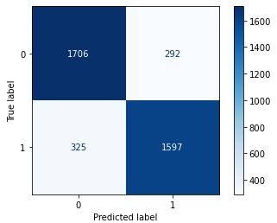
Model 1aii
Classification Algorithm | Random Forest
Vectorizer | Countvectorizer
Word Form | Tokenized
Train set accuracy score | 0.85771
Test set accuracy score | 0.84260
F1 score | 0.83810
0 = DisneyPlus and 1 = Netflix
Notes:
For the next model, we only replace the tf-idf with countvectoriser while keeping the rest the same.
We get a training score of about 0.86 and a testing score of around 0.84. The F1 score is at 0.84, and the confusion matrix is as shown.

Slide 9
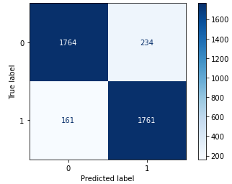
Model 1bi
Classification Algorithm | Logistic Regression
Vectorizer | TF-IDF
Word Form | Tokenized
Train set accuracy score | 0.94304
Test set accuracy score | 0.89923
F1 score | 0.89915
0 = DisneyPlus and 1 = Netflix
Notes:
Next, we used logistic regression with the tf-idf vectoriser and tokenized word form.
Same thing, we have the train score, test score, f1 score and confusion matrix.
Even though the F1 score increased, we can see signs of overfitting as train >> test.

Slide 10
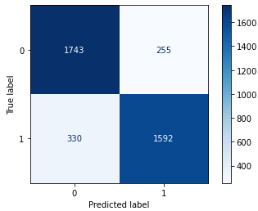
Model 1bii
Classification Algorithm | Logistic Regression
Vectorizer | Countvectorizer
Word Form | Tokenized
Train set accuracy score | 0.86128
Test set accuracy score | 0.85076
F1 score | 0.84478
0 = DisneyPlus and 1 = Netflix
Notes:
Next, we replace the tf-idf with countvectoriser while keeping the rest the same.
train score, test score, f1 score and confusion matrix as shown.
We continued experimenting with other models using different word forms - lemmatised and stemming and we get 12 models in total.
Pass over to Jance for the evaluation of the 12 models.

Slide 11
Evaluation
In addition to the training and testing accuracy score (to look for overfitted models), we will be looking at the F1 score as well
We are a neutral company, and we seek to minimise both
false negatives (classified as disneyplus even though they should be classified as netflix) and
false positives (classified as netflix even though they should be classified as disneyplus)
We seek to optimise the F1 score, which will give us the harmonic mean of precision and recall scores.
Notes:
We want to correctly identify the posts for both netflix and disneyplus as we have no preference for either and want to know which platform will provide the best reach for our productions. Hence, we place emphasis on the F1 score, which give us a balance view between falsely identified netflix and d+ category.

Slide 12
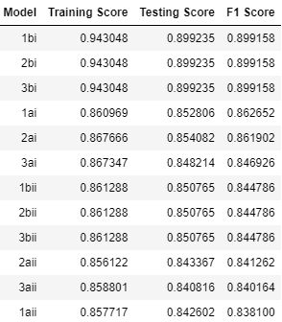
Evaluation
Classification Algorithm | Random Forest
Vectorizer | TF-IDF
Word Form | Tokenized
Train set accuracy score | 0.86096
Test set accuracy score | 0.85280
F1 score | 0.86265
0 = DisneyPlus and 1 = Netflix
Notes:
Model 1ai is the best model after evaluating all the models based on trade-off between accuracy, F1 score and overfitting

Slide 13
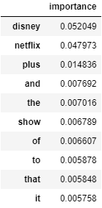
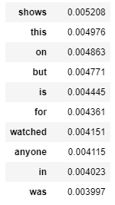
Evaluation
From the top 20 words, other than the top 3 words: 'disney', 'netflix' and 'plus', which probably relates to disneyplus, netflix and disneyplus respectively, the remaining words seem to be quite generic.
The top 2 words is also ~4-5x more important than the 3rd/4th words.
This tells us that if our movie reviews do not have 'disney' or 'netflix' in them (which is highly likely since our shows are not on either platforms yet), our model may possibly have a hard time classifying the reviews. This would possibly impact the accuracy of our model.
Top 1 - 10 words Top 11 - 20 words
Notes:
There is however a weakness in the model as we found that the top 3 words with the highest importance in the model are disney, netflix and plus. The top 2 words are about 4 -5 times more important than the third and fourth words. This shows that if the new posts do not have the words disney and netflix, the accuracy of the model might be lower.

Slide 14
Recommendations
Improvement to the model could be made by
removing words with high correlation to the subreddits such as 'disney', 'netflix', 'plus'
Adjust the weight of ‘disney’, ‘netflix’
Notes:
We recommend to improve the model by removing words that are highly correlated to the subreddits, adjust the weight of disney and netflix

